Slide 1



PROJECT MANAGEMENT IN PRACTICE
Leadership Theory & PM Skills
Lecture No: 9 Week: 10
Vispi Shroff
vispi.shroff@ul.ie
Sub Heading
And Date

Slide 2

Recap
Last week, we looked at
Cost Estimation
Project Budgets
Earned Value Management and its benefits

Slide 3
Today’s Topics & Learning Outcomes
Leadership Theory
Project Management Skill-sets

Slide 4
Leadership Theory
Are leaders born?
We like tall, dark, handsome leaders… and male..?
Read ‘Blink’ - Malcolm Gladwell or
http://www.gladwell.com/blink/blink_excerpt2.html
Leadership can’t be taught… only experience can make you a good leader?
- Leadership is the same as management?

Slide 5
Leadership vs. Management
Leadership
Management

Slide 6
History & Progression
Leader Traits
Focussed on the physical attributes of leaders
Contingency Theories of Leadership
Normative Decision Model
Focuses on improving decision making to determine level of participation; autocratic, consultative or group process
Situational Leadership Model
Leader behaviour based on supportive relationships and task behaviour
Contingency Model
Path-Goal Model

Slide 7
Interactional Framework for Leadership
Leadership
Personality,
Position,
Expertise, etc
Values,
Norms, Cohesiveness,
etc
Tasks,
Stress, Environment,
etc
Followers
Situation

Slide 8
The Roles a PM plays
A Facilitator
Manager-as-Facilitator vs. Manager-as-Supervisor
Systems Approach – A project is a system
Avoid micromanagement

Slide 9
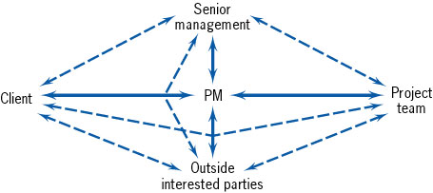
The Roles a PM plays
- A communicator

Slide 10
The Roles a PM Plays
Virtual Project Manager
- Geographically Dispersed Teams
Challenges involved
Different times
Different languages
Different cultures
Boils down to effective communications
Meetings can facilitate communications, but don’t overcook it.
Read (Mantel, et. al, 2008), Chapter 7 for tips on effective meetings

Slide 11
Responsibilities of a PM
- Leadership
Negotiation, Conflict Resolution, and Persuasion
- Acquiring Resources
- getting necessary quantity and quality can be key challenge
- “irrational optimism”
Fighting Fires and Obstacles

Slide 12
Skill-sets for Selection of a PM
- Credibility - The PM must be believable
- technical credibility
- administrative credibility
- Sensitivity - Politically Astute and Aware of Interpersonal Conflict
- Leadership, Style, Ethics - Ability to Direct Project in Ethical Manner

Slide 13
What does a good PM need to have?
The Project
Management
PM Specialist
Capabilities
Behavioural
Capabilities
Body of Knowledge
Generally Accepted
Project Management
Knowledge and Practice
PMBOK® Guide
General
Management
Business
Capabilities
Application
Knowledge
Area Knowledge
and Practice
and Practice
Two views of PM skill-sets

Slide 14
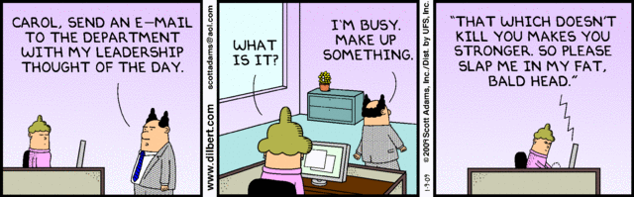
Any Thoughts, Questions, Ideas?

Slide 15
Reading Materials for the Week
Schwalbe, K. – Information Technology Project Management – Chapter 8
PMBOK – Chapter 8

Slide 16
Conclusions
We looked at
Leadership theory
Leadership myths
Leadership and Management
PM Roles
PM Responsibilities
PM Skill-Sets

Slide 17
References
Mantel, Jr., S.J. et al., 2008. Project Management in Practice 3rd ed., US: John Wiley & Sons, Incorporated.
Hughes, R.L., Ginnett, R.C. & Curphy, G.J., 2009. Leadership: Enhancing the Lessons of Experience Sixth., Singapore: McGraw Hill.
Gladwell, M., Why do we love tall men? Available at: http://www.gladwell.com/blink/blink_excerpt2.html [Accessed January 3, 2009].
Gladwell, M., 2005. Blink, Little, Brown and Company.

